Slide 1
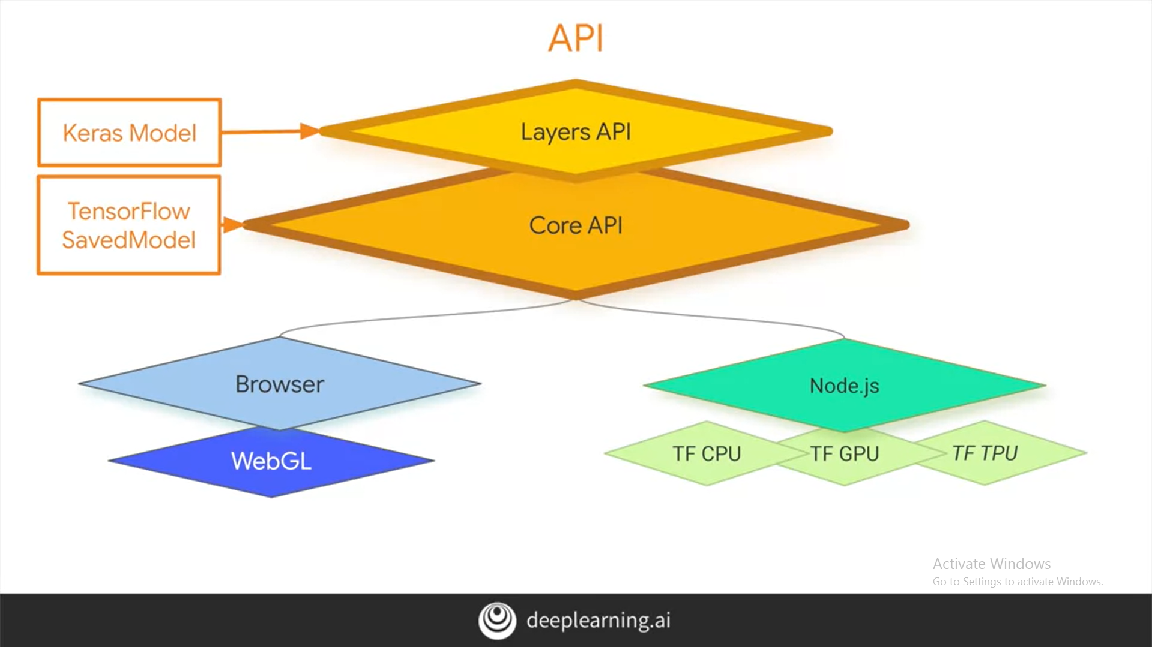
Notes:
In this course, you're going to take a look at training and inference using JavaScripts.
This will allow you to take your knowledge of Machine Learning models and use them in the browser as well as on backend servers like Node.js.
We're going to start in the browser, and this week you're going to build some basic models using JavaScript,
and you'll execute them in a simple web page. Let's start with a quick review of the design and architecture of TensorFlow.js, and you can see that here.
The goal is twofold. First, we want to make it easy for you to code against it with a friendly high-level API, but you can also go lower into
the APIs and program against them directly too. It's designed to run in the browser as well as an Node.js server.

Slide 2
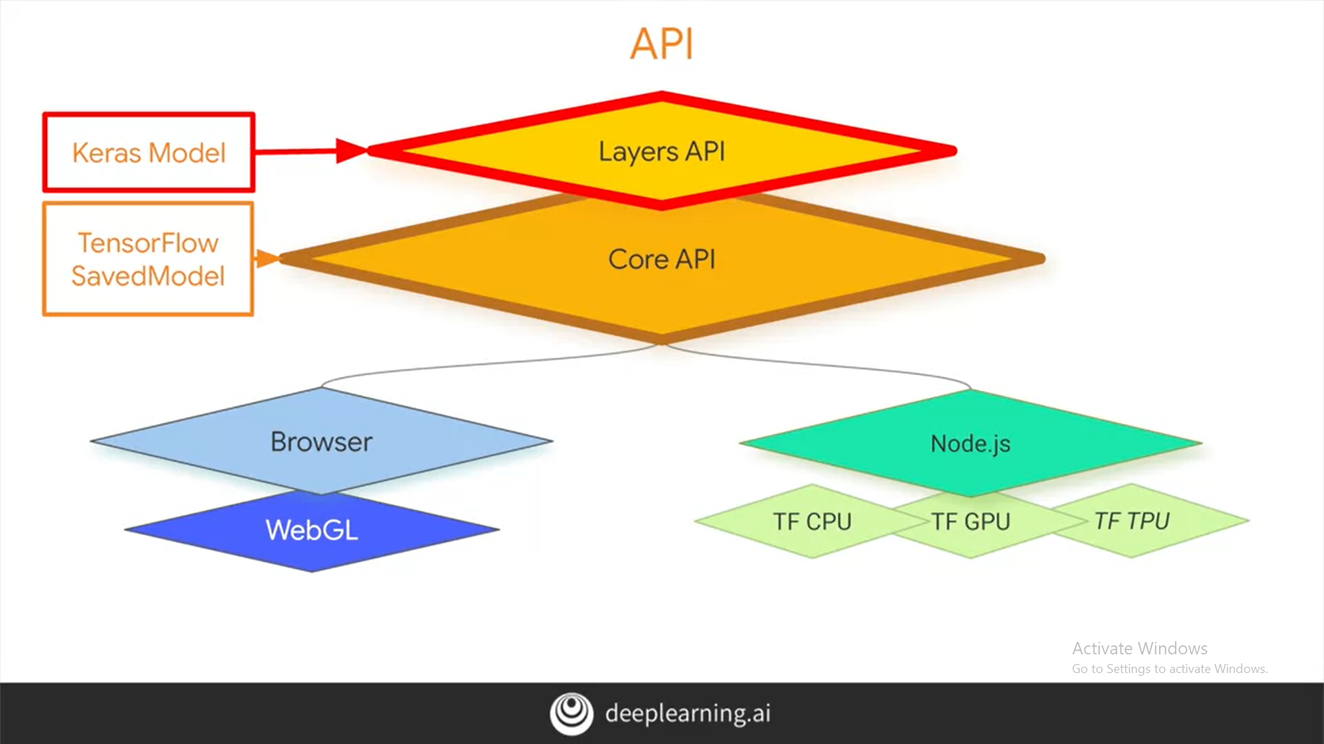
Notes:
Up to this point, you've been programming convolutional neural networks and deep neural networks using the Keras API in TensorFlow.
The layers API and TensorFlow.js looks and feels a lot like Keras. So what you've been learning, you'll be able to use albeit with a slightly different syntax due
to using JavaScript instead of Python.

Slide 3
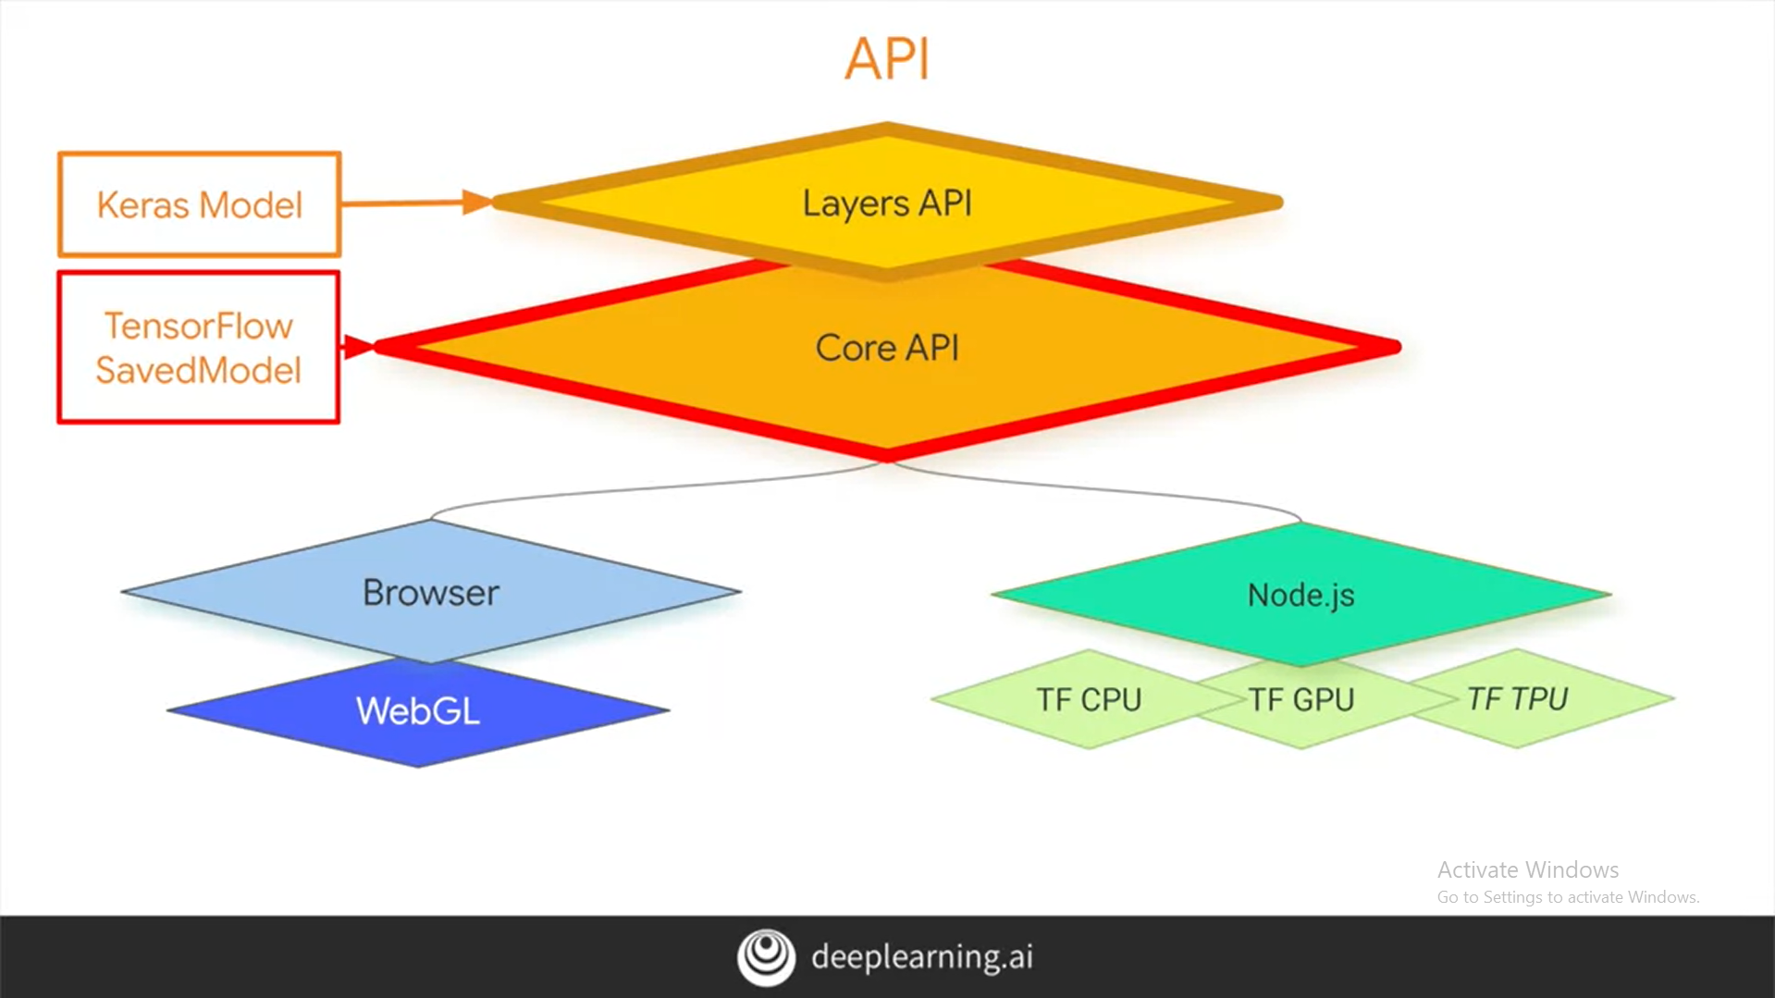
Notes:
The low-level APIs are called the core APIs. They're designed to work with a TensorFlow saved model formats, which in TensorFlow 2.0 is designed to be
a standard file format which can be used across the Python APIs, the JavaScript once, and even TensorFlow Lite for mobile and embedded devices.

Slide 4
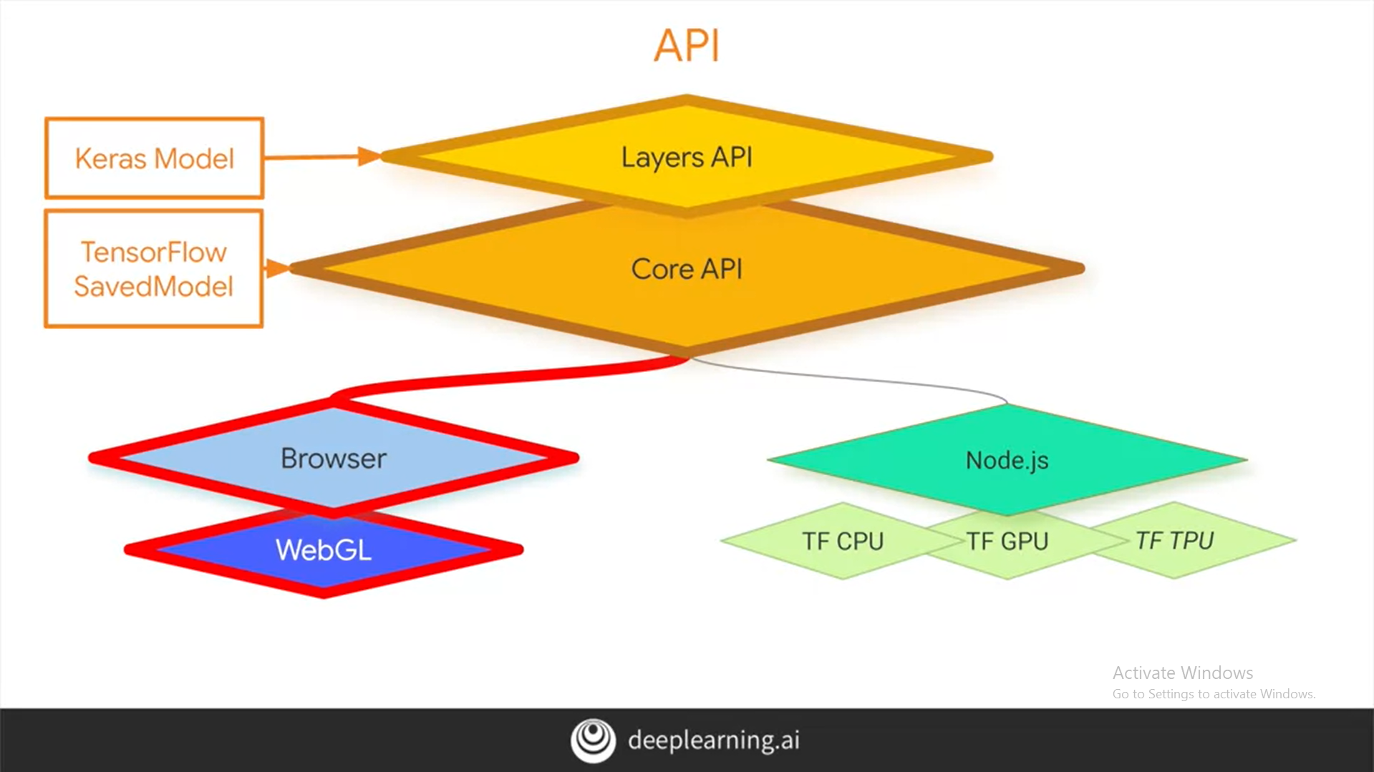
Notes:
The Core API then works with the browser and can take advantage of WebGL for accelerated training and inference.

Slide 5
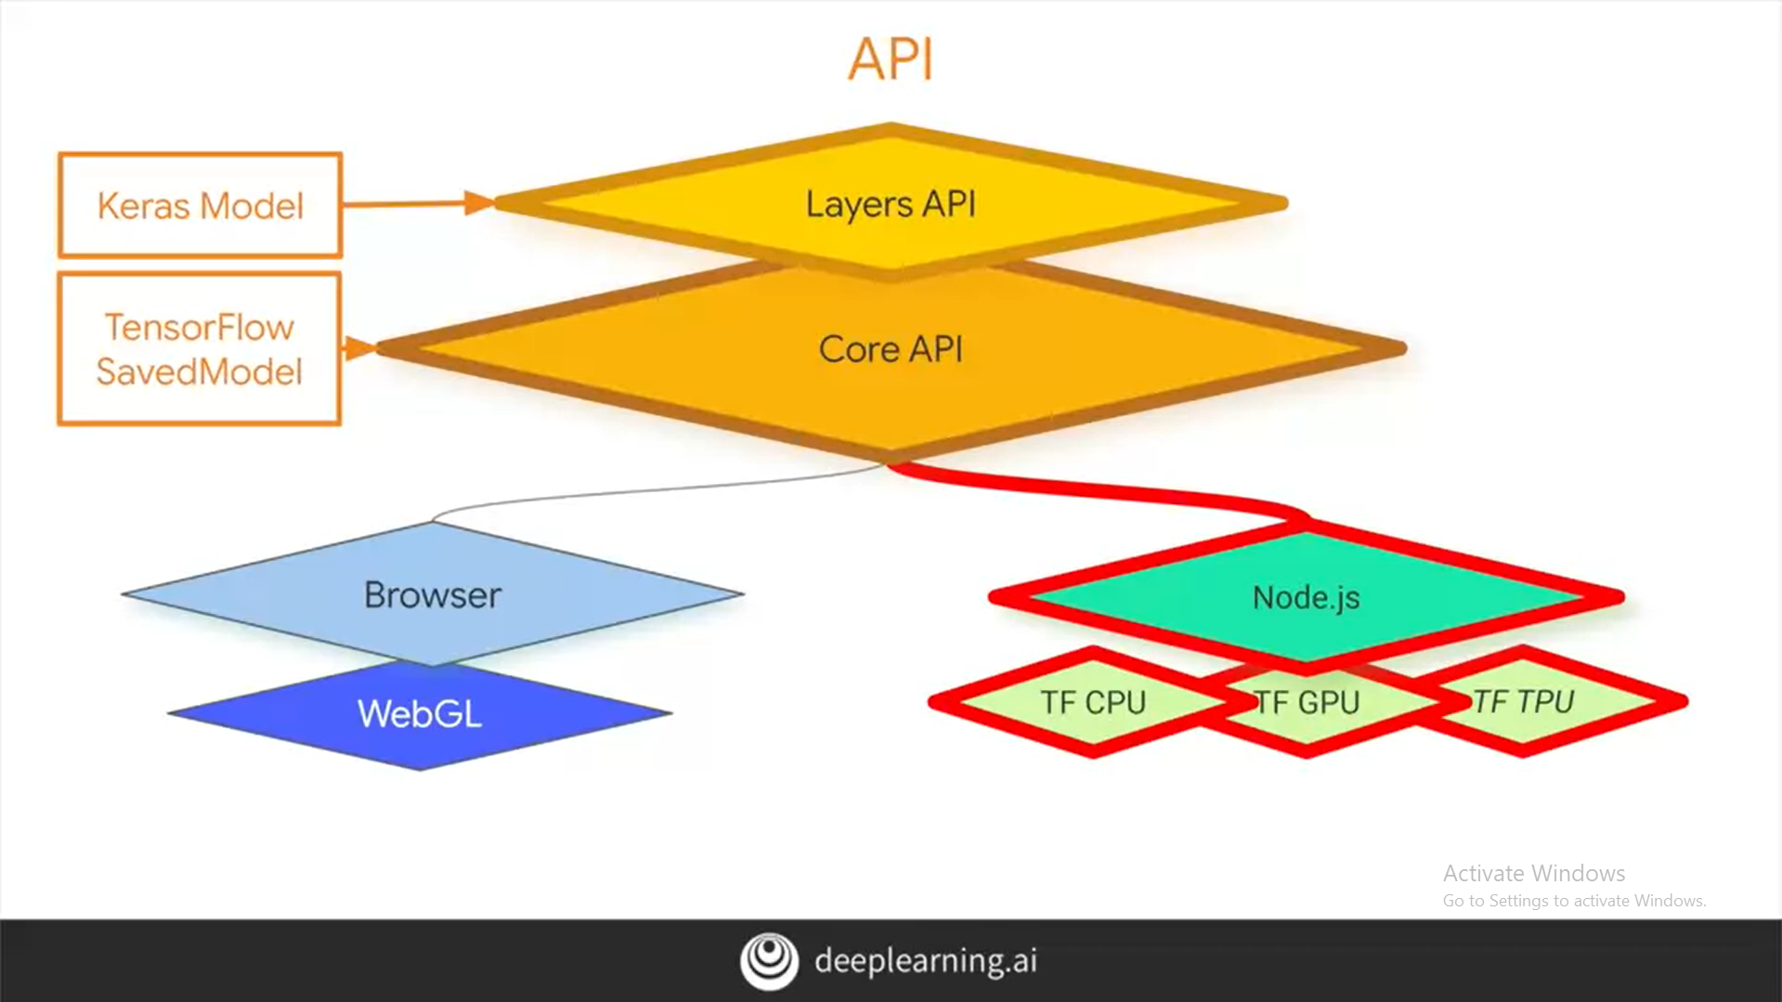
Notes:
Also on Node.js, you can build server-side or terminal applications using it. These can then take advantage of CPUs, GPUs, and TPUs depending on what's available to your machine.
We're going to build the simplest possible neural network. One which matches two sets of numbers to see that the relationship between them is y equals two x minus 1.
We'll do that in JavaScript.

